Slide 1


Power BI & Dynamics 365
Highlight The Value of Dynamics Biz Apps With Analytics

Slide 2
Engage Business Decision Makers with Dynamics 365 Analytics
The objective is to sell the value of Dynamics
Analytics is more than Pie Charts and Graphs
Analytics captures the imagination of the BDM
PowerBI gives US an unfair advantage
Notes:
Selling PowerBI might be a virtuous Side Effect, but Selling Dynamics is the Focus of our Conversation
PowerBI is crushing the competition and it’s crazy to not use it – It’s like an Ace or a Draw-Four card – use it!
We have visuals within Dynamics – they are great for end-users, but BDMs / Managers / Business Analysts need more
The visuals and intelligence built into PowerBI engage the imagination of BDMs
BDMs don’t care how many clicks it takes to get to the center of an opportunity; this appeals to their needs.

Slide 3

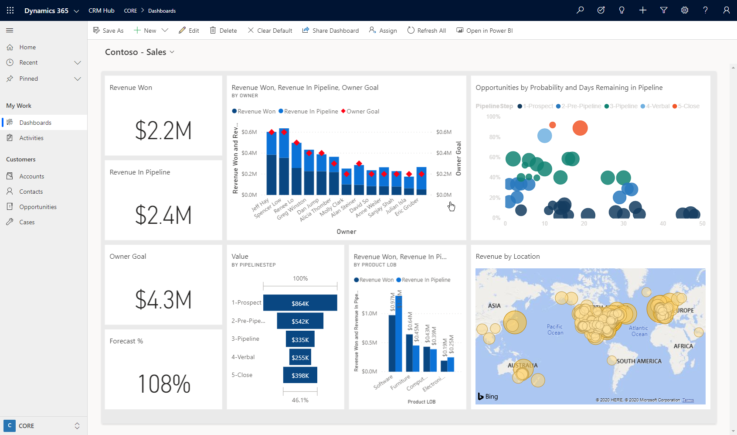
Show Me
Interactive Visualizations
What-If Exploration
No Code AI
Ask Questions, Get Answers
KPIs and Time Series Charts
Analytics on Entity forms
Notes:
Let’s take a look at several features of showing PowerBI within Dynamics that help engage and dare I say, Delight? Business Decision Makers

Slide 4
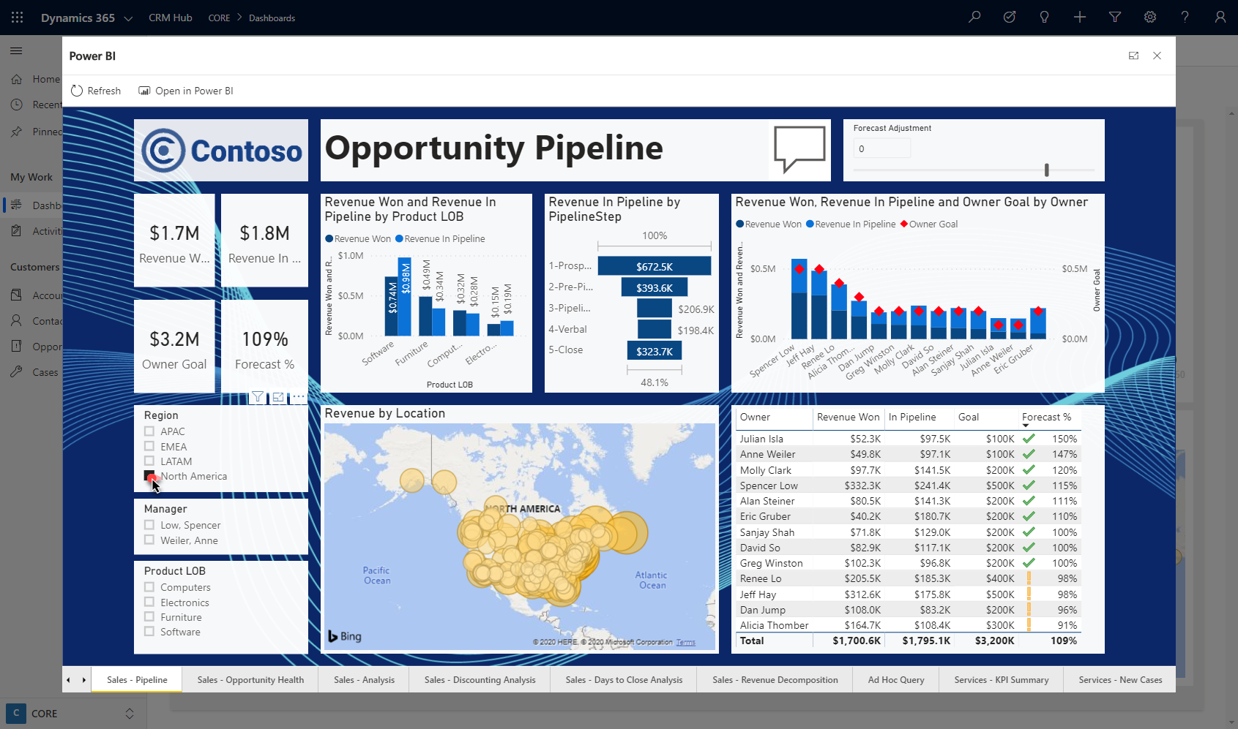
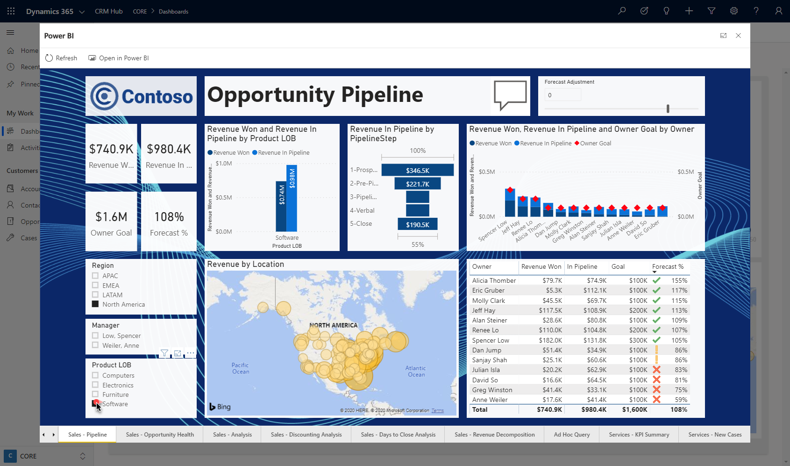
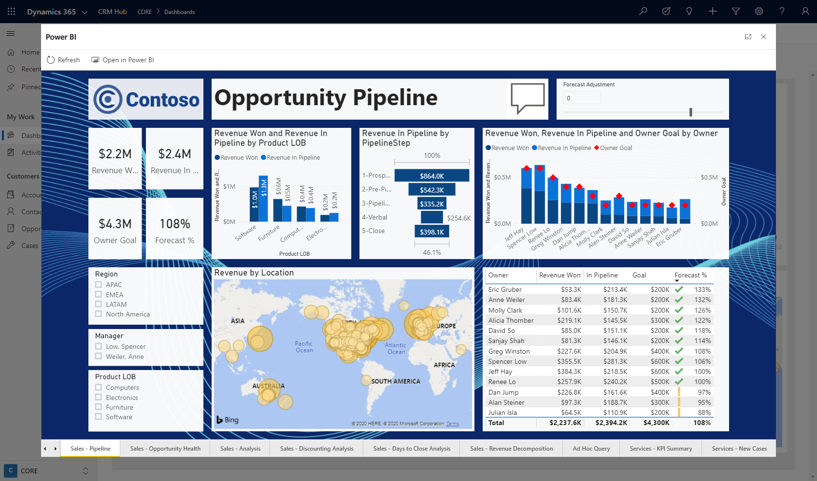
Show Me
Interactive Visualizations
What-If Exploration
No Code AI
Ask Questions, Get Answers
KPIs and Time Series Charts
Analytics on Entity forms
Notes:
Probably everyone on the call has interacted with a PowerBI dashboard – and seen the filtering and cross-highlighting
If the data model is built out to resemble CDS, we can filter on a Region and see the rest of the report, such as the maps or charts, respond

Slide 5
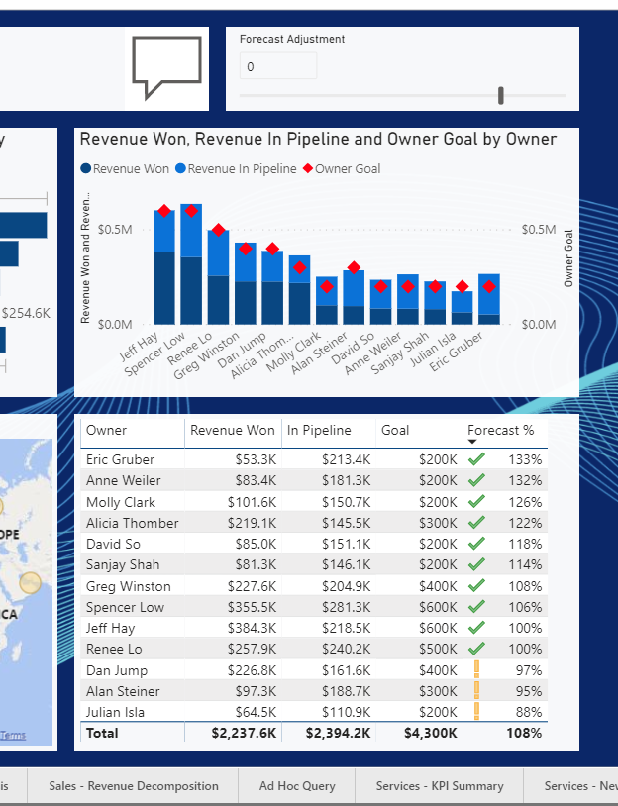
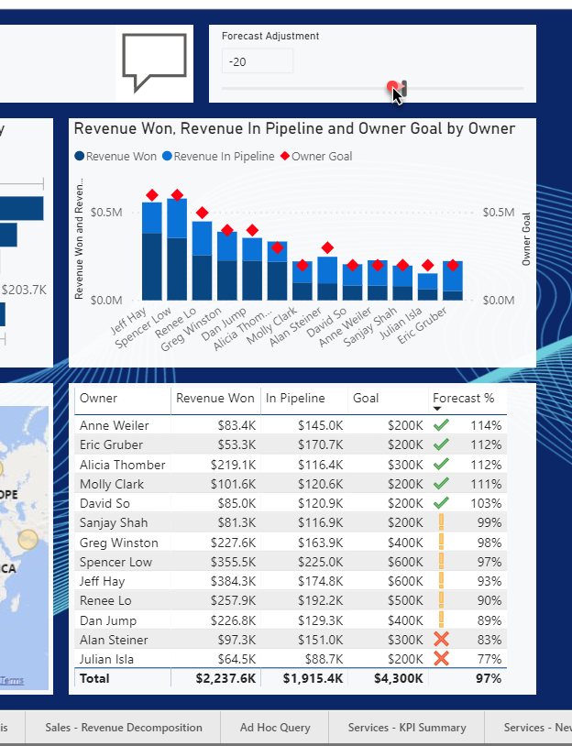
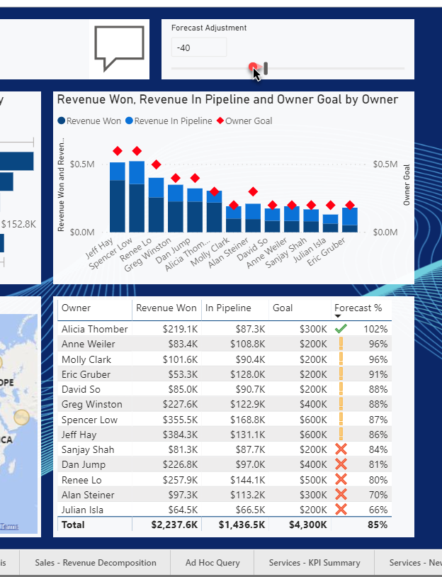
Show Me
Interactive Visualizations
What-If Exploration
No Code AI
Ask Questions, Get Answers
KPIs and Time Series Charts
Analytics on Entity forms
Notes:
Take a look at the right side of the screen, I have a Graph and a Table showing a Sales Pipeline – I’ll Zoom in now -
At the Top of the area, There’s a Forecast Adjustment Slider – This demonstrates how a manager can interactively adjust one value (in this case an estimate of how much of the forecasted pipeline they want to assume will close)
As they adjust it, the chart and table respond –
You can see how as we lower our forecast expectations by 40%, more users show up with a warning or a red X –meaning they are at risk of not making quota unless they beat expectations.

Slide 6
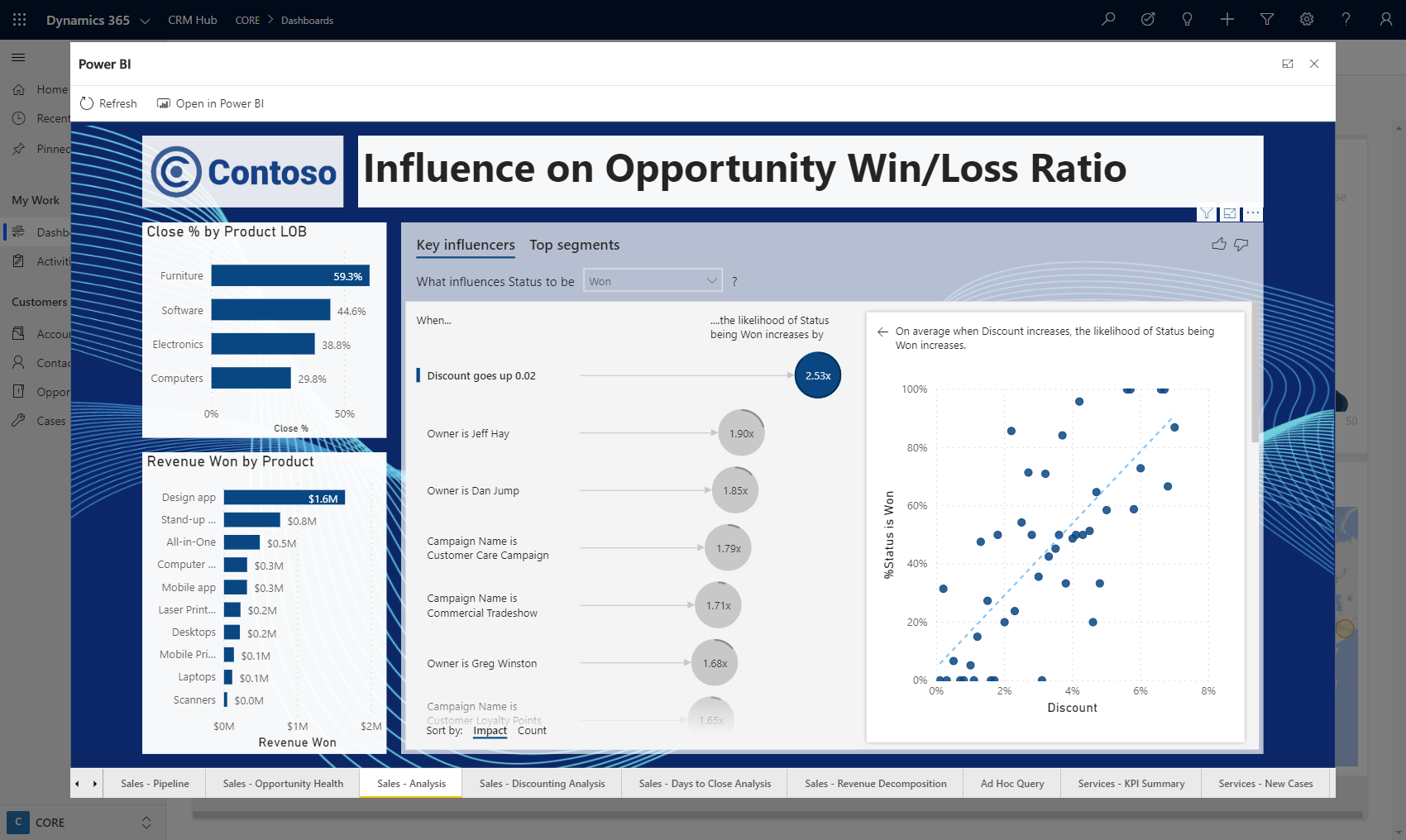
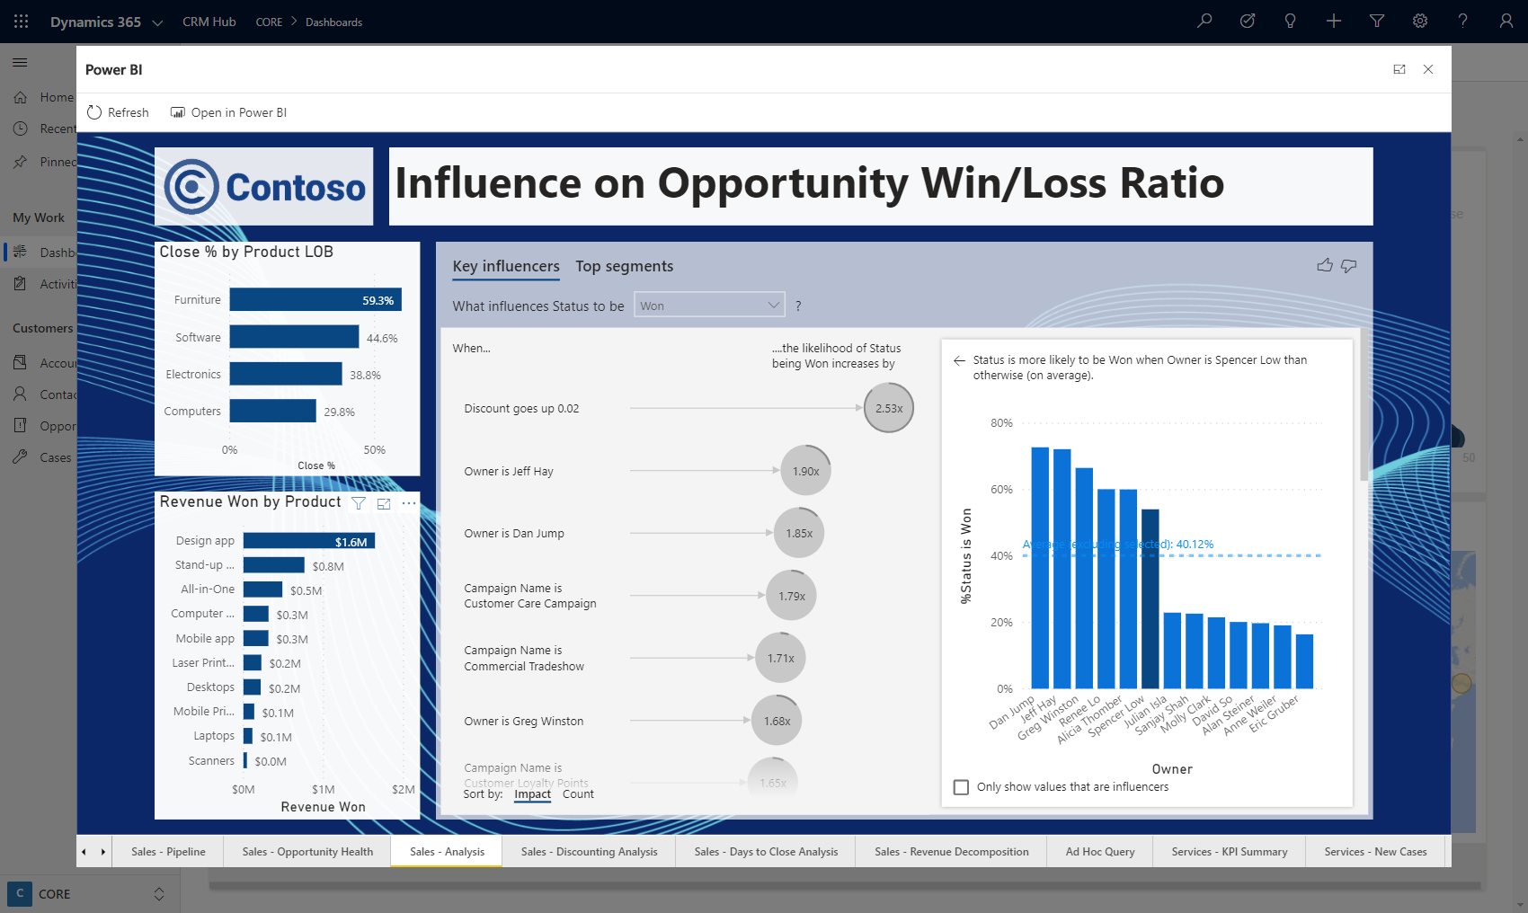
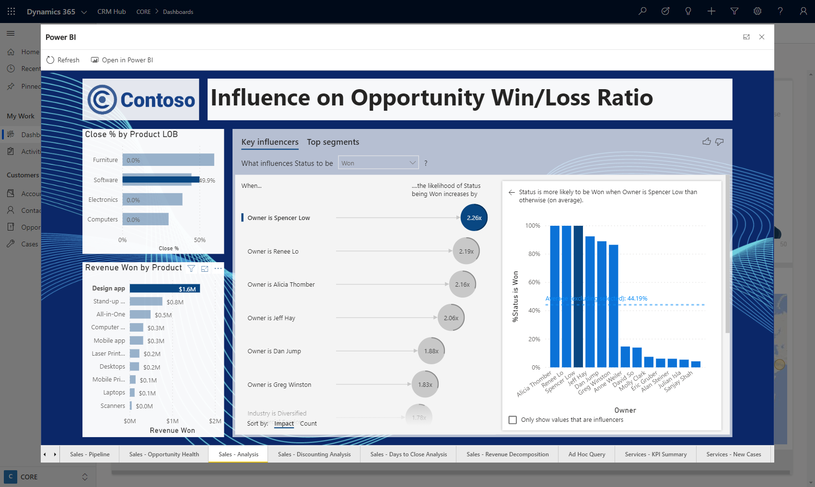
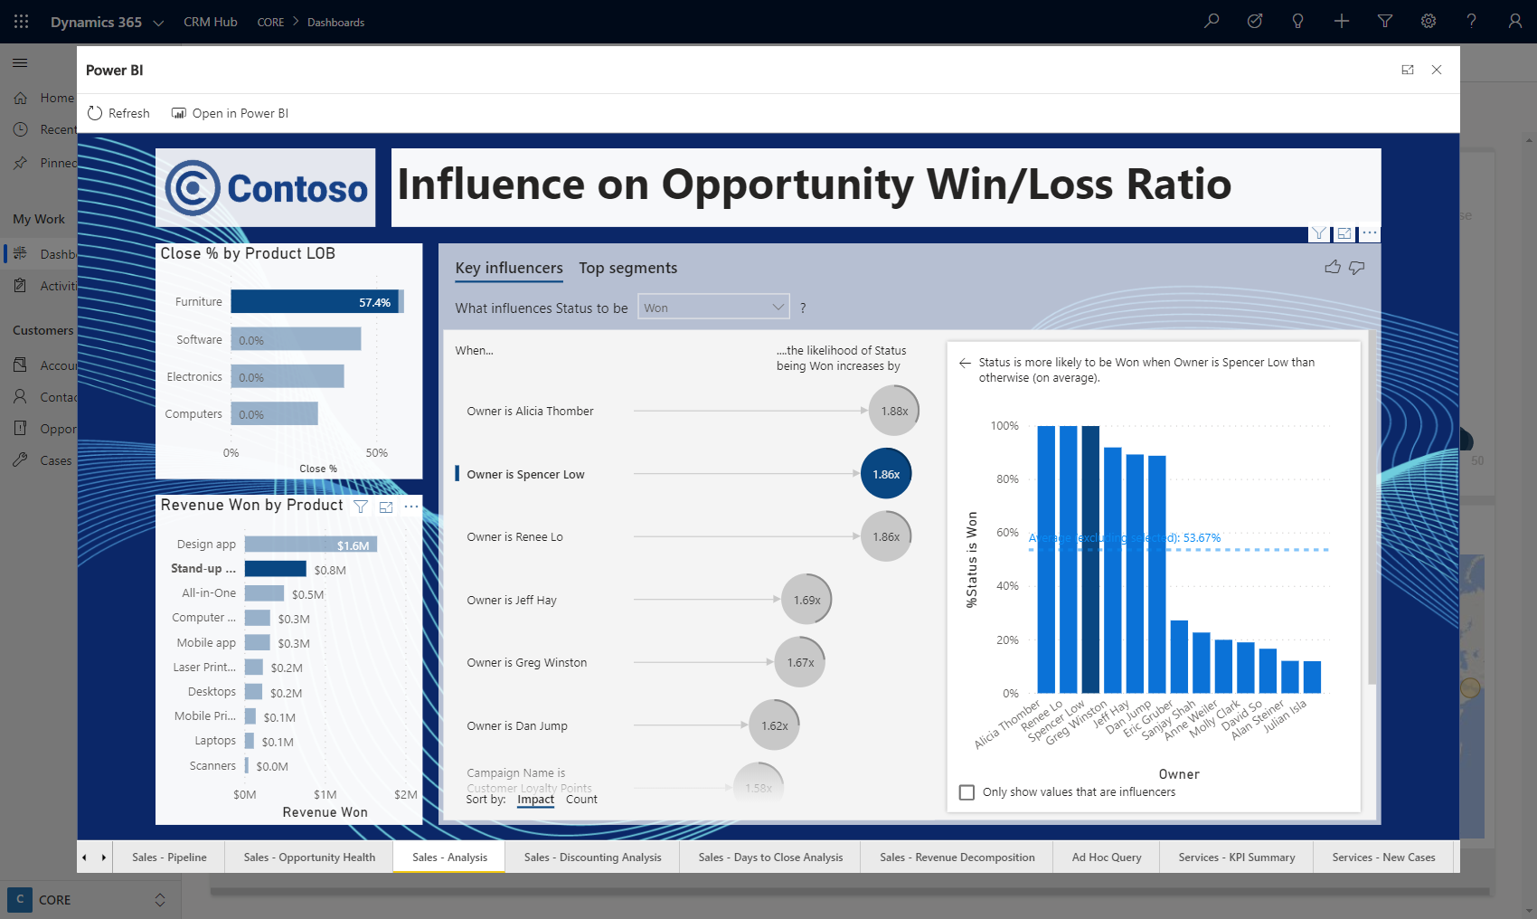
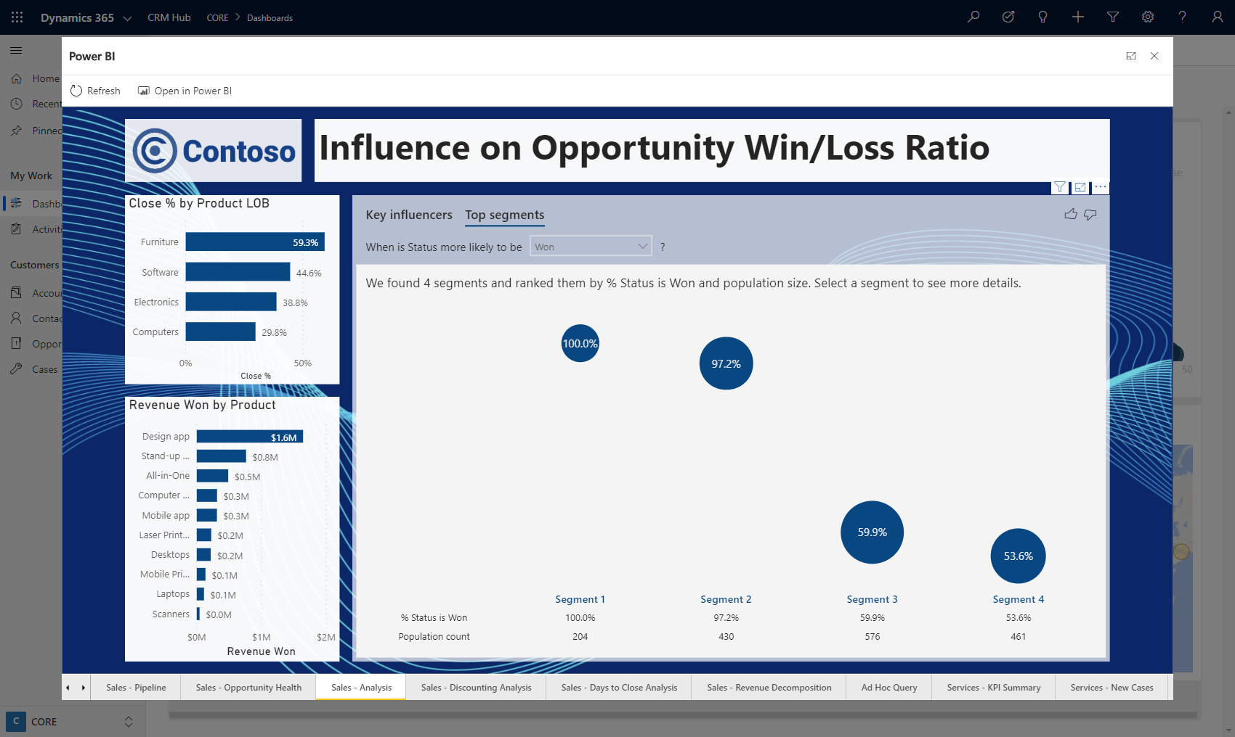
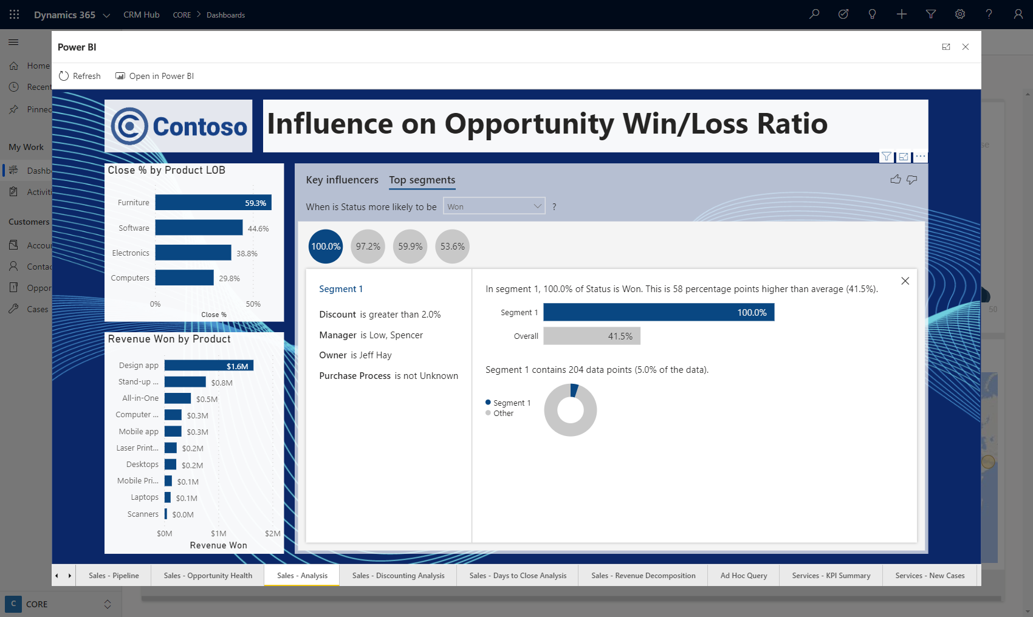
Show Me
Interactive Visualizations
What-If Exploration
No Code AI – Key Influencer
Ask Questions, Get Answers
KPIs and Time Series Charts
Analytics on Entity forms

Slide 7
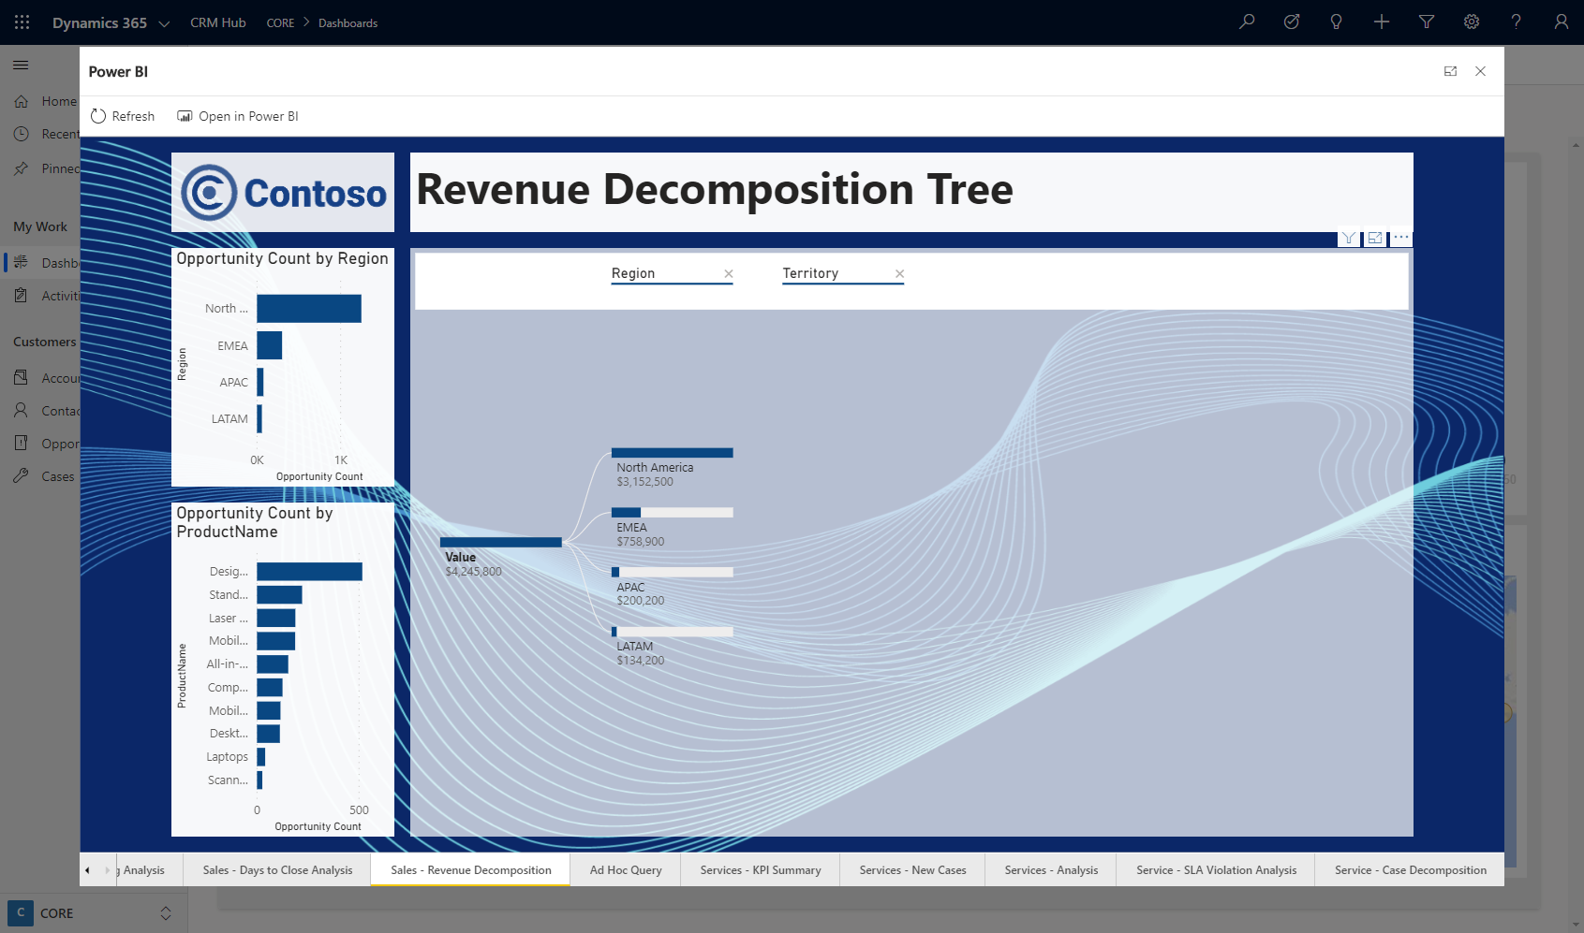
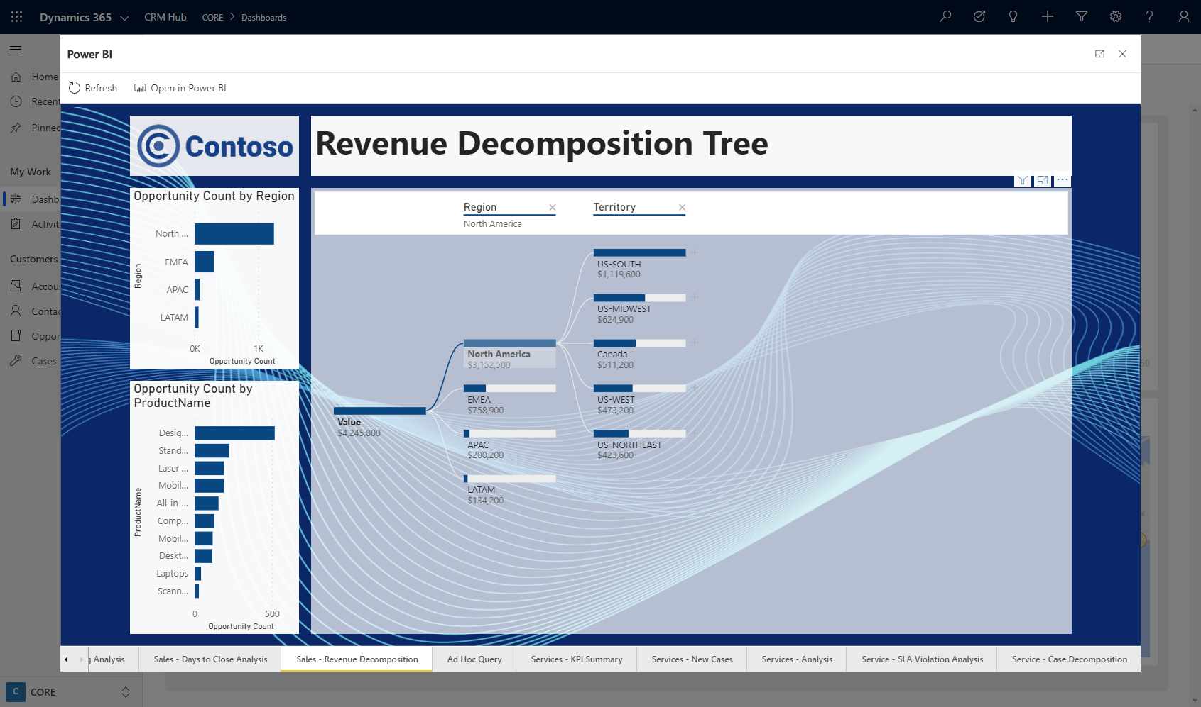
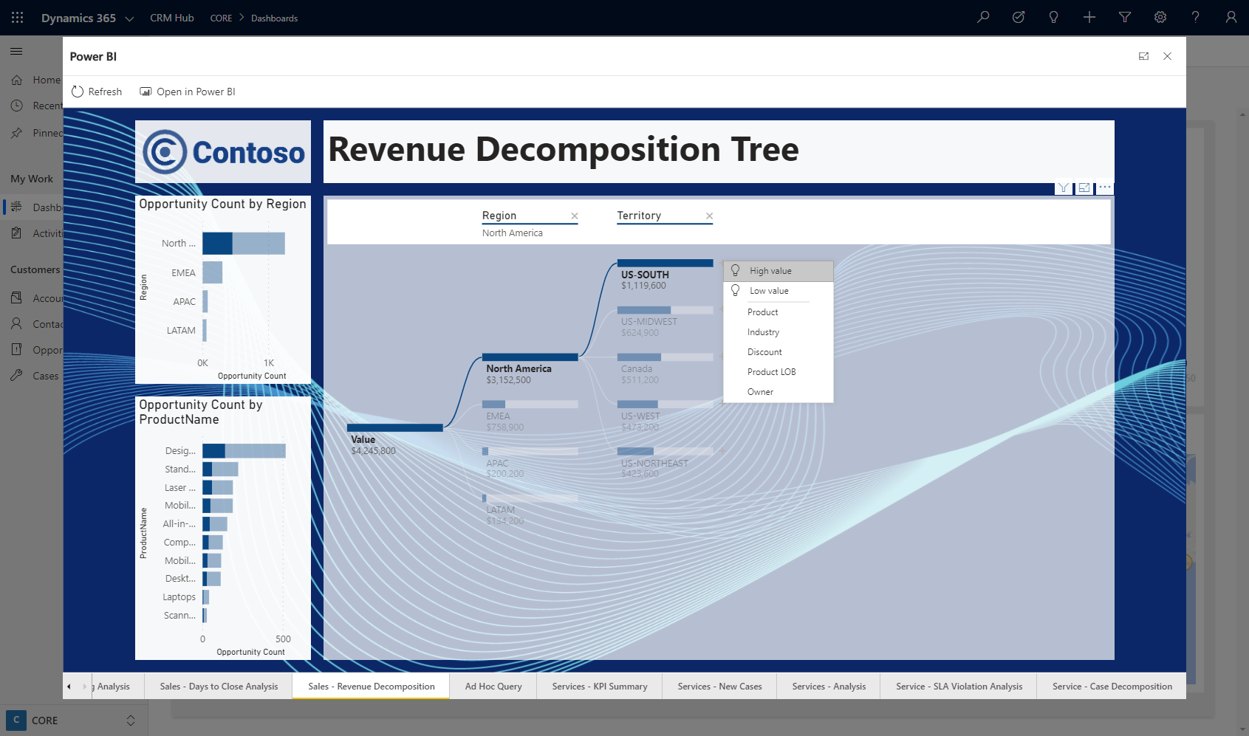
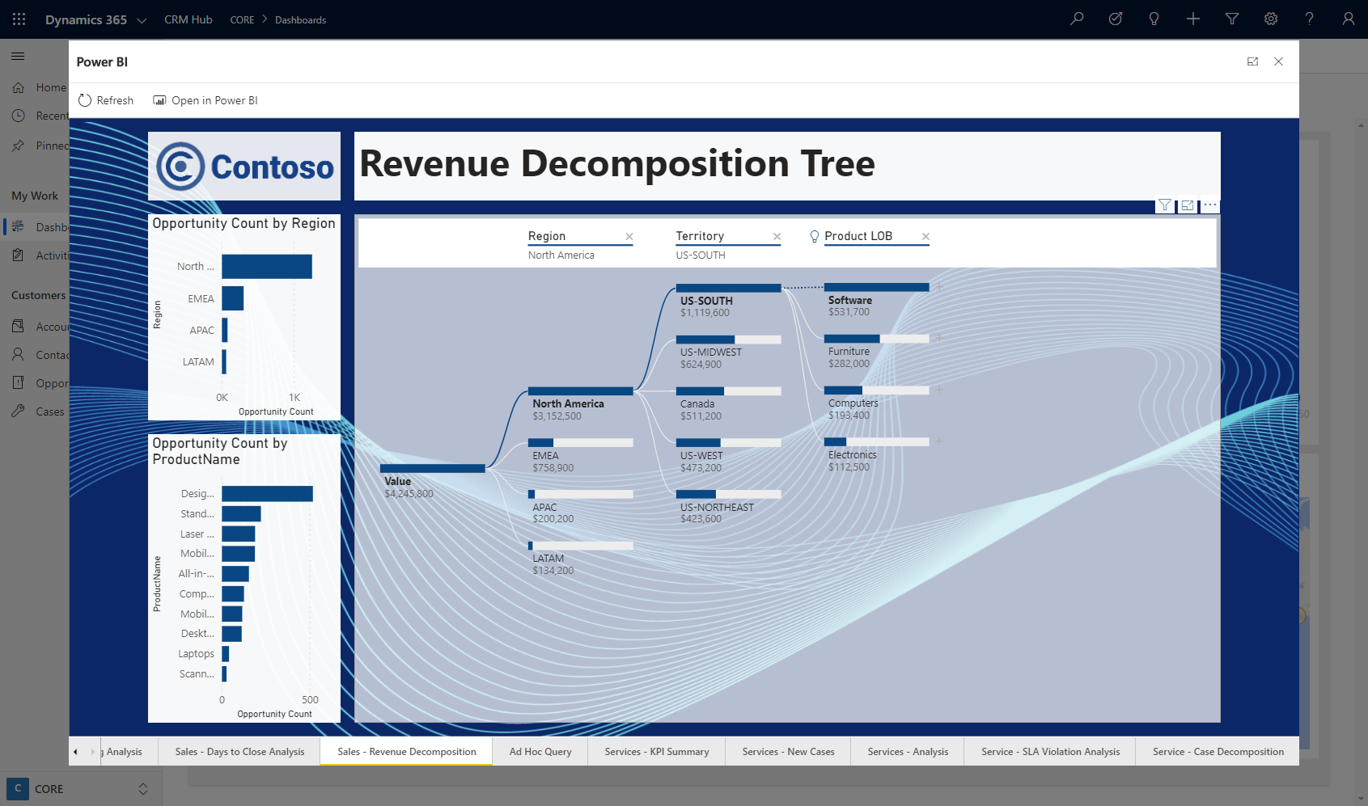
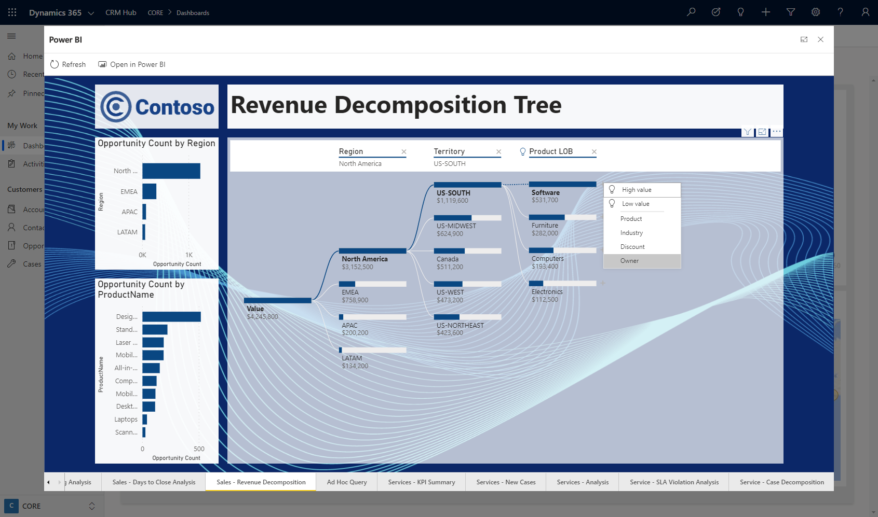
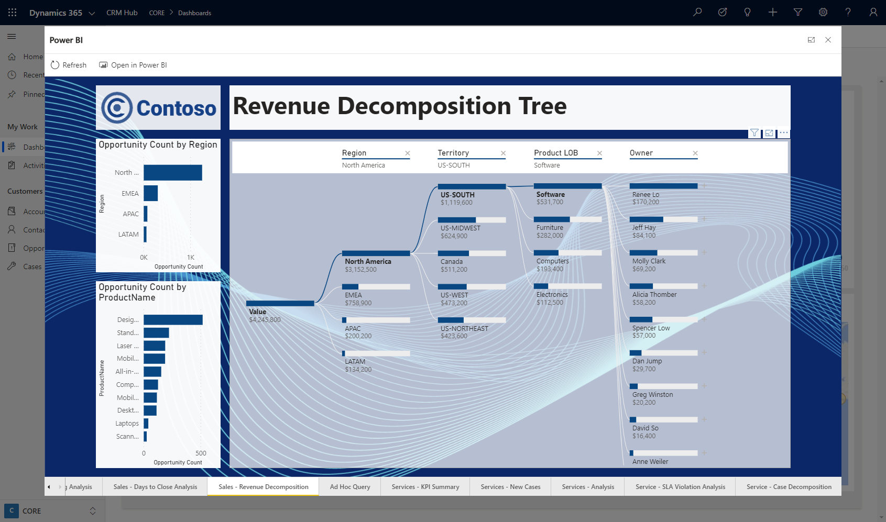
Show Me
Interactive Visualizations
What-If Exploration
No Code AI – Decomp Tree
Ask Questions, Get Answers
KPIs and Time Series Charts
Analytics on Entity forms

Slide 8
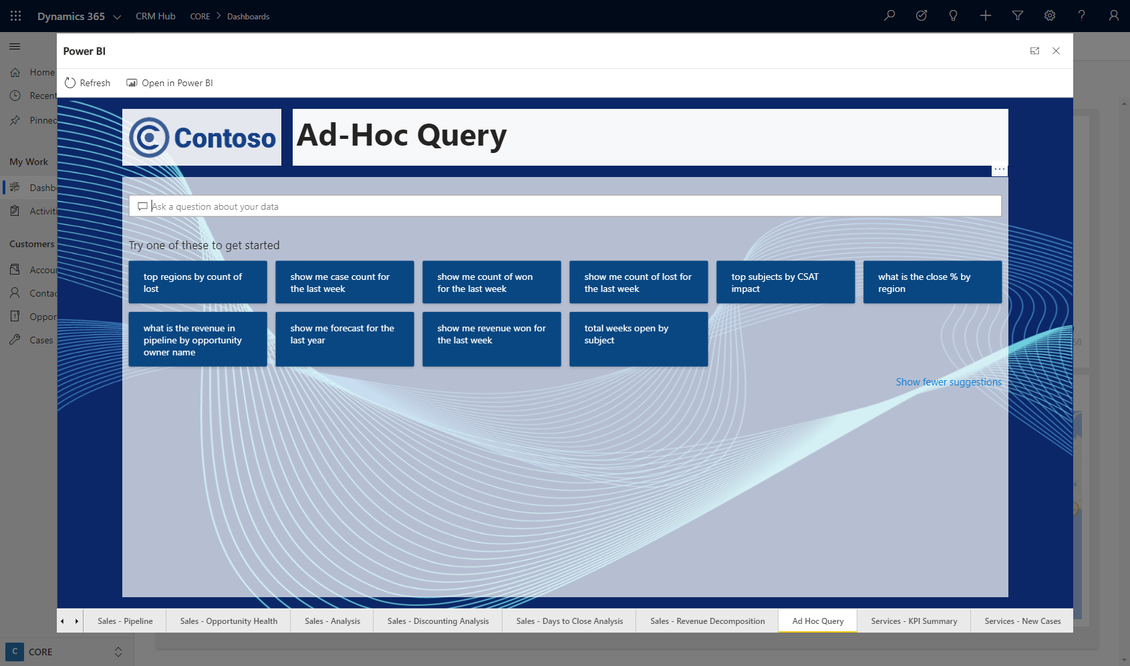
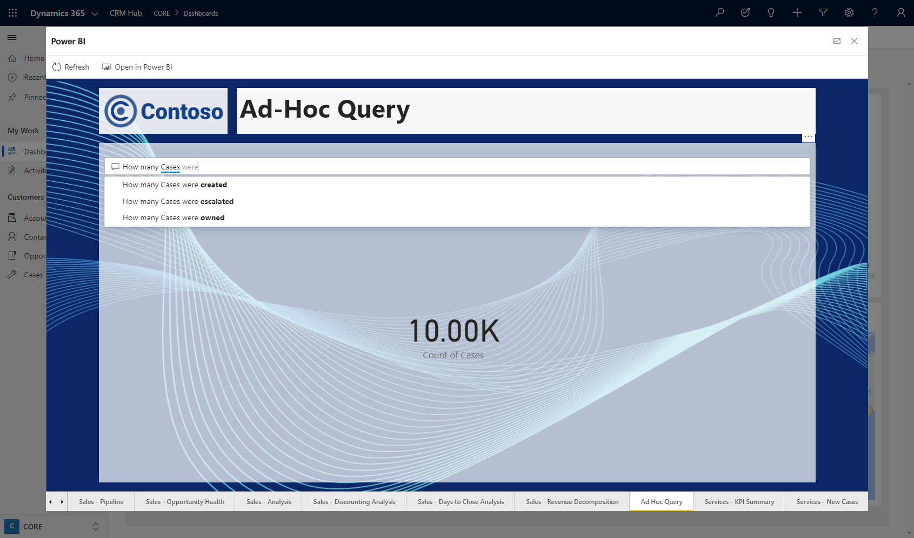
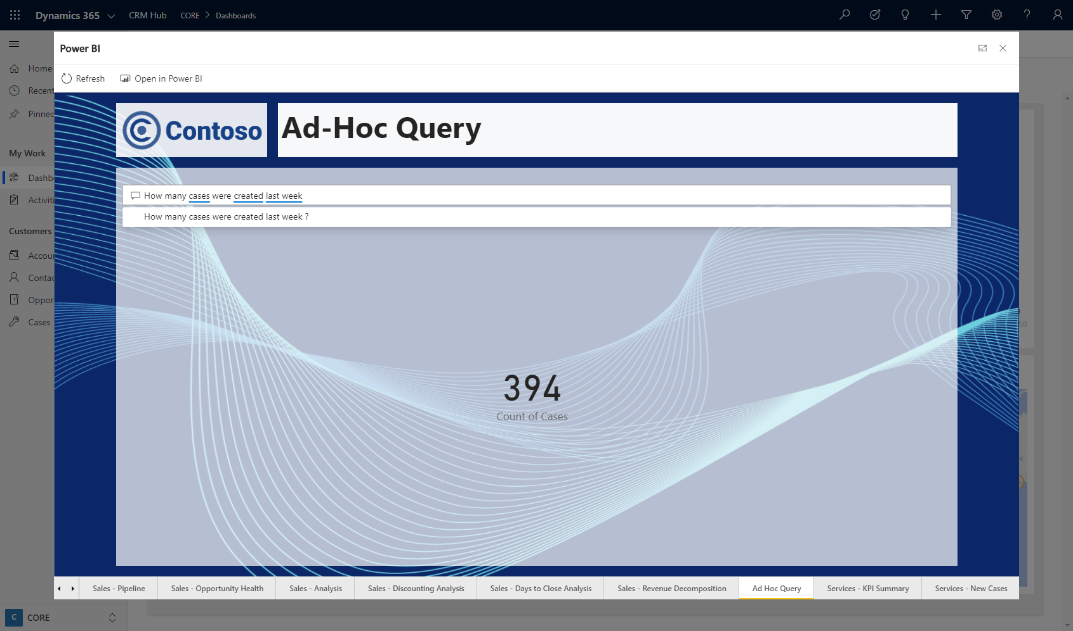
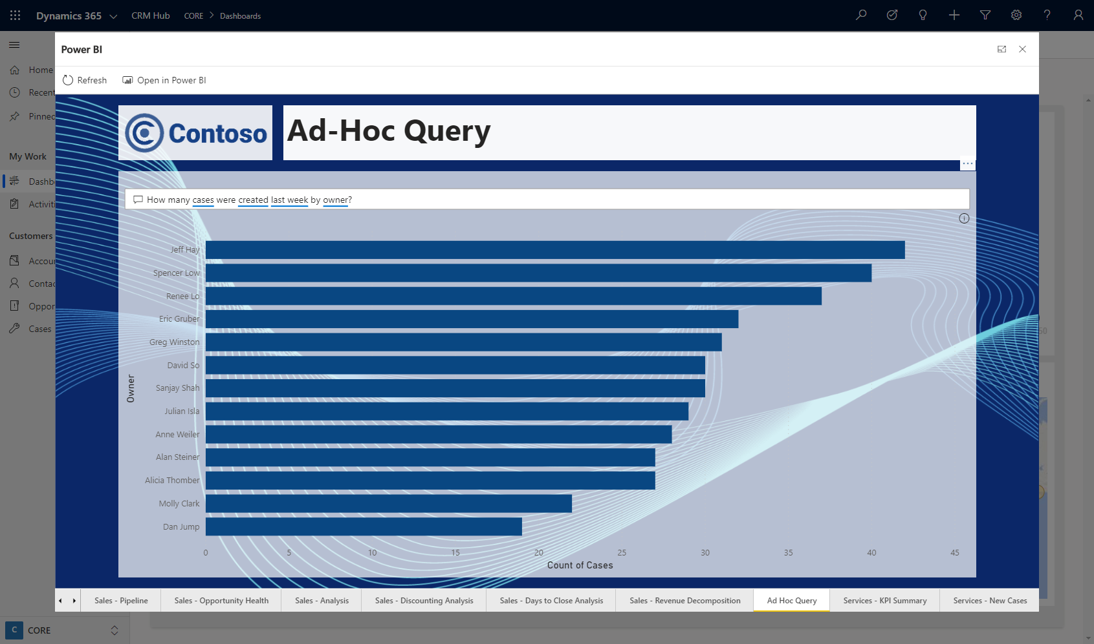
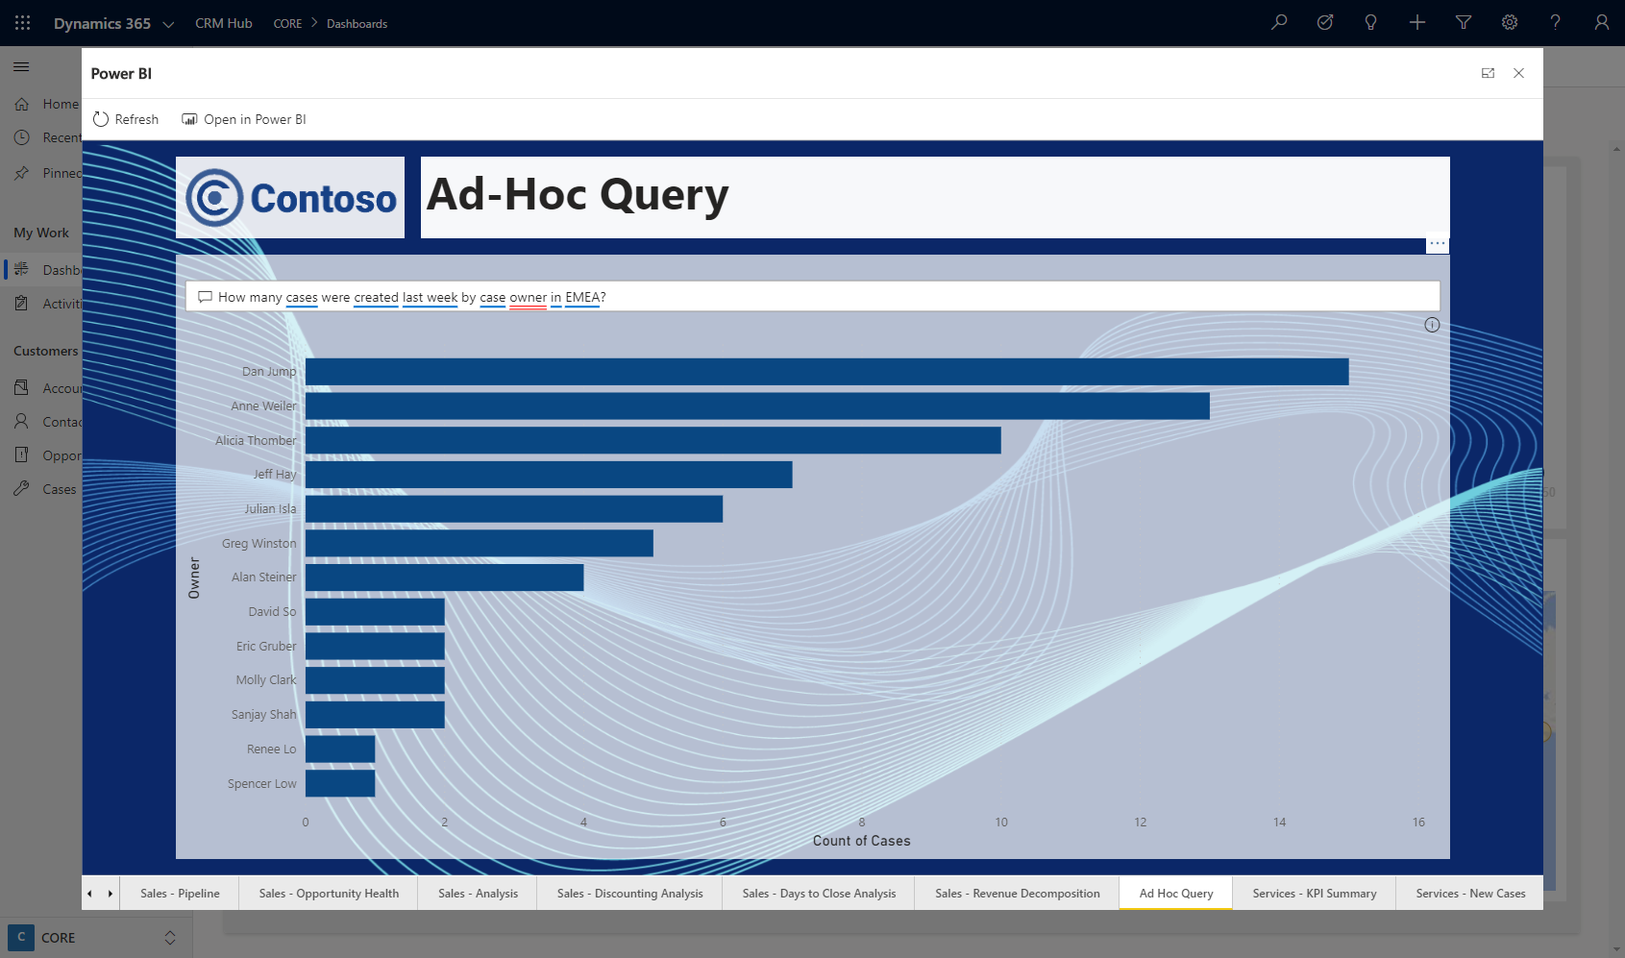
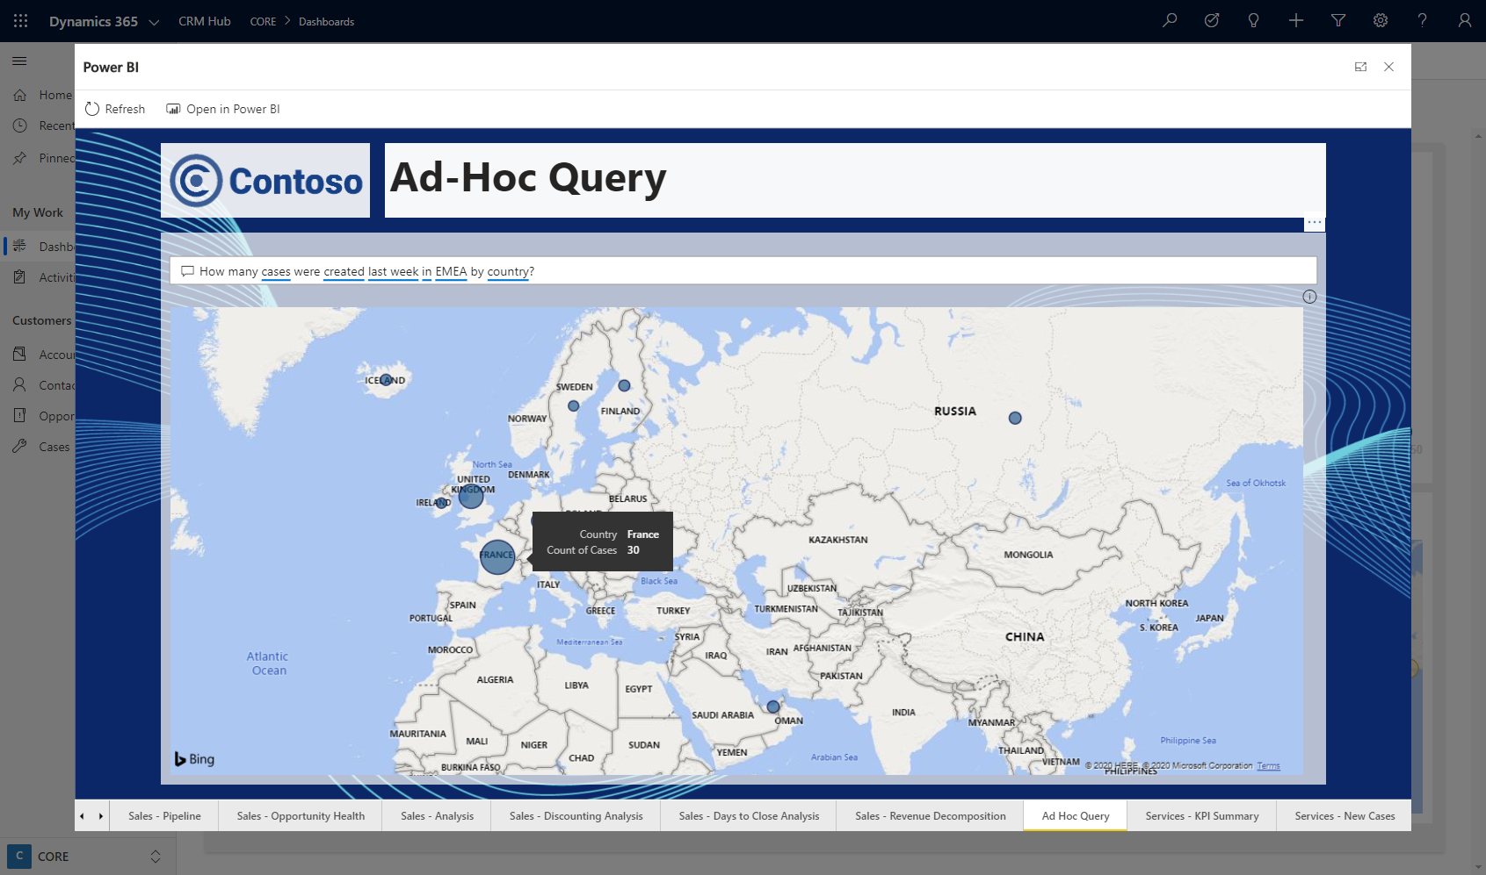
Show Me
Interactive Visualizations
What-If Exploration
No Code AI
Ask Questions, Get Answers
KPIs and Time Series Charts
Analytics on Entity forms

Slide 9
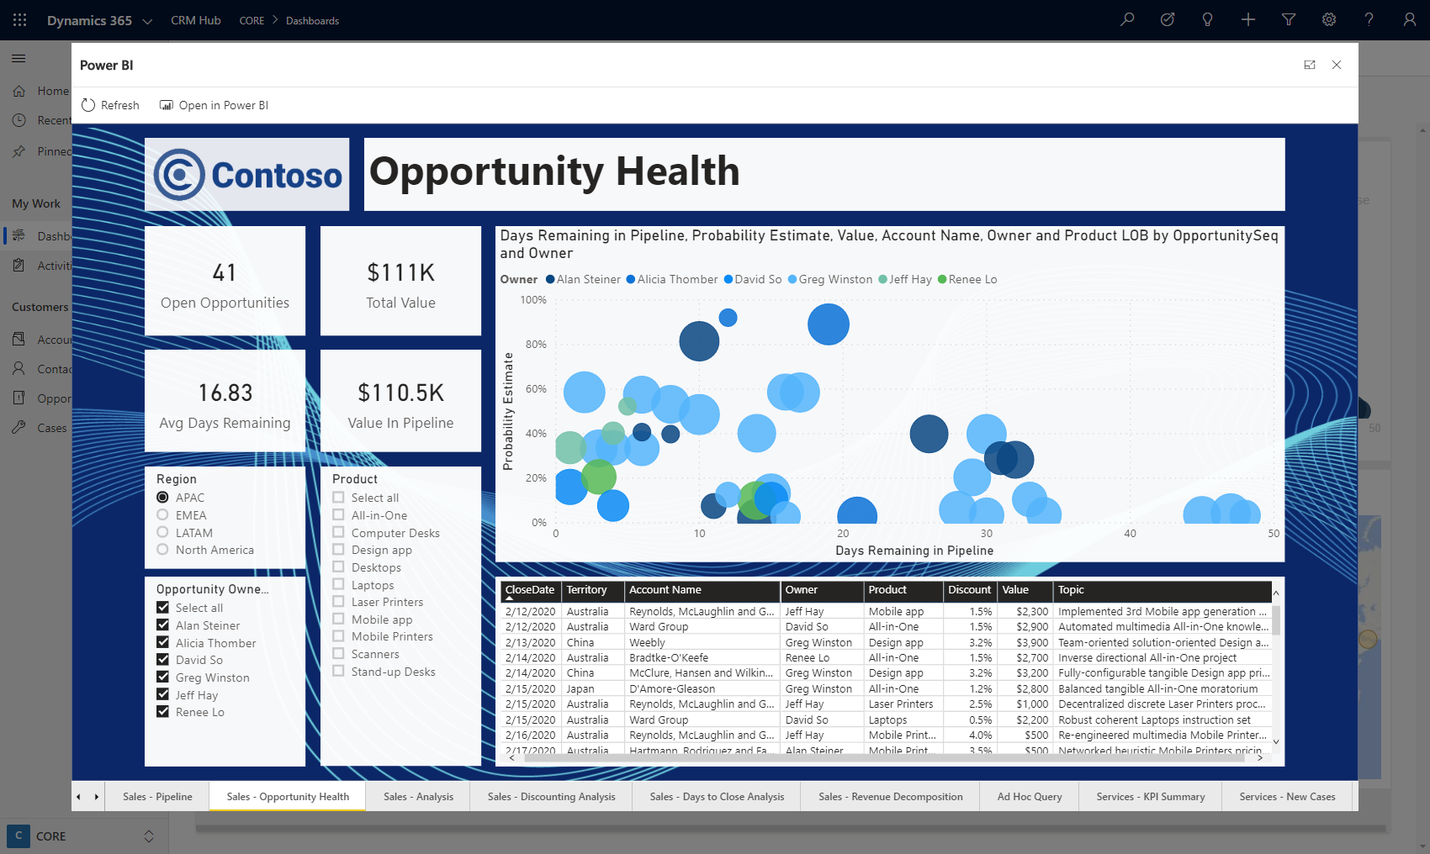
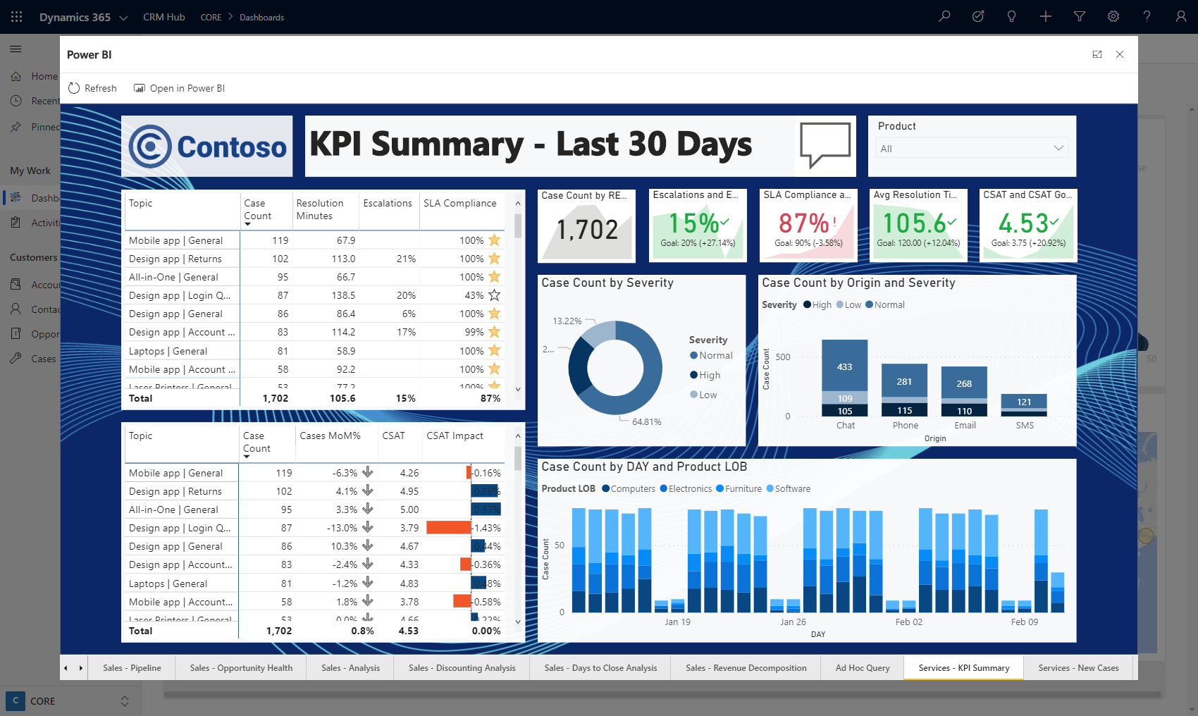
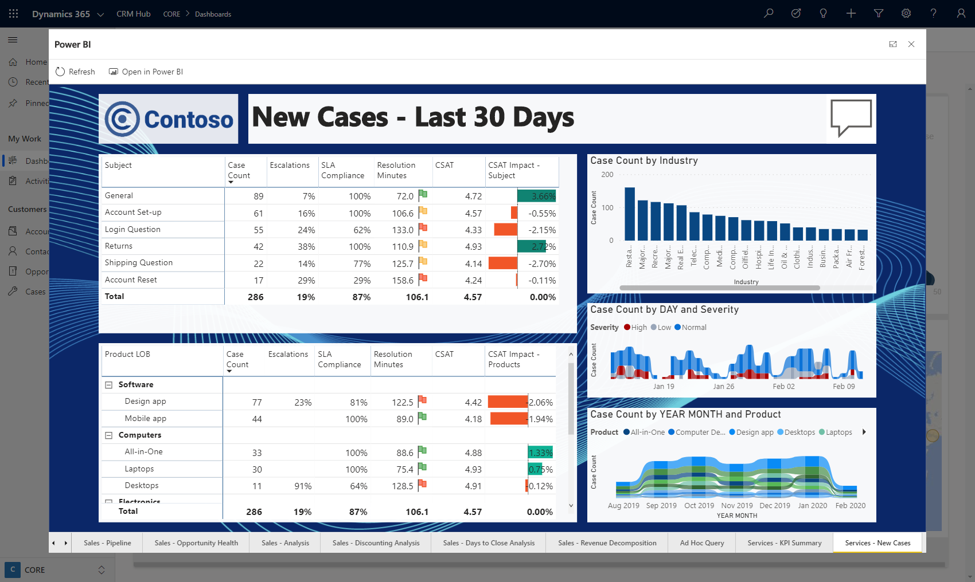
Show Me
Interactive Visualizations
What-If Exploration
No Code AI
Ask Questions, Get Answers
KPIs and Time Series Charts
Analytics on Entity forms

Slide 10
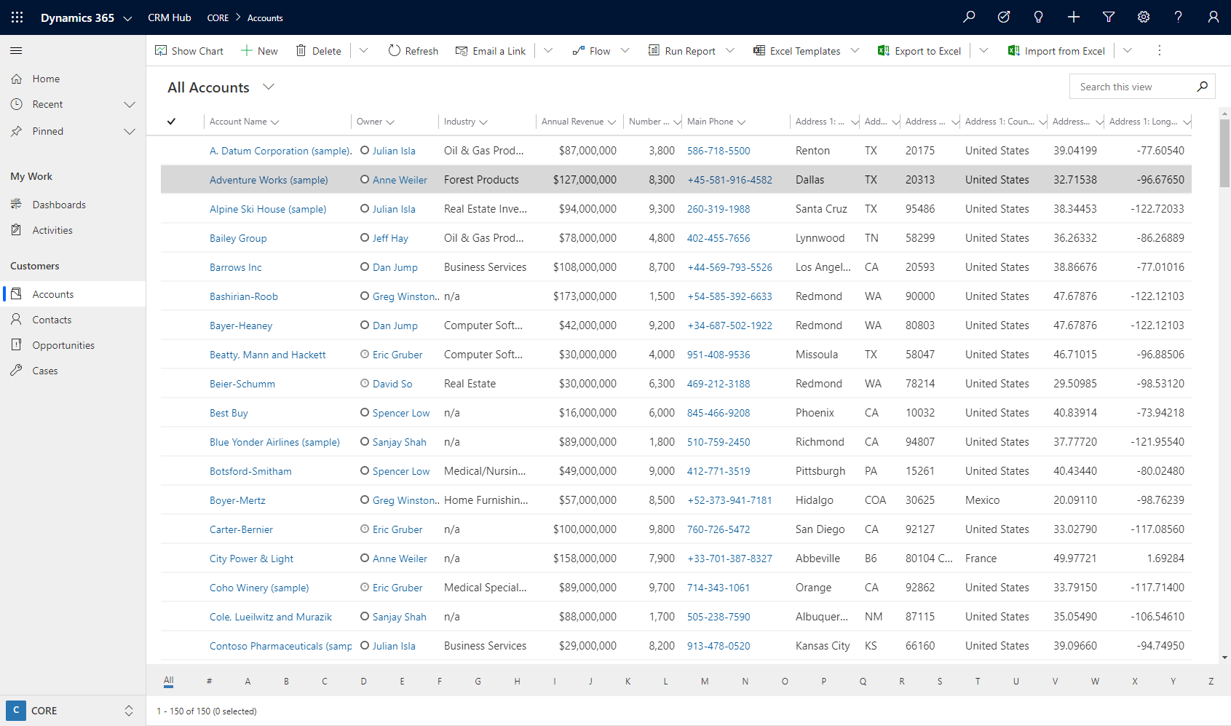
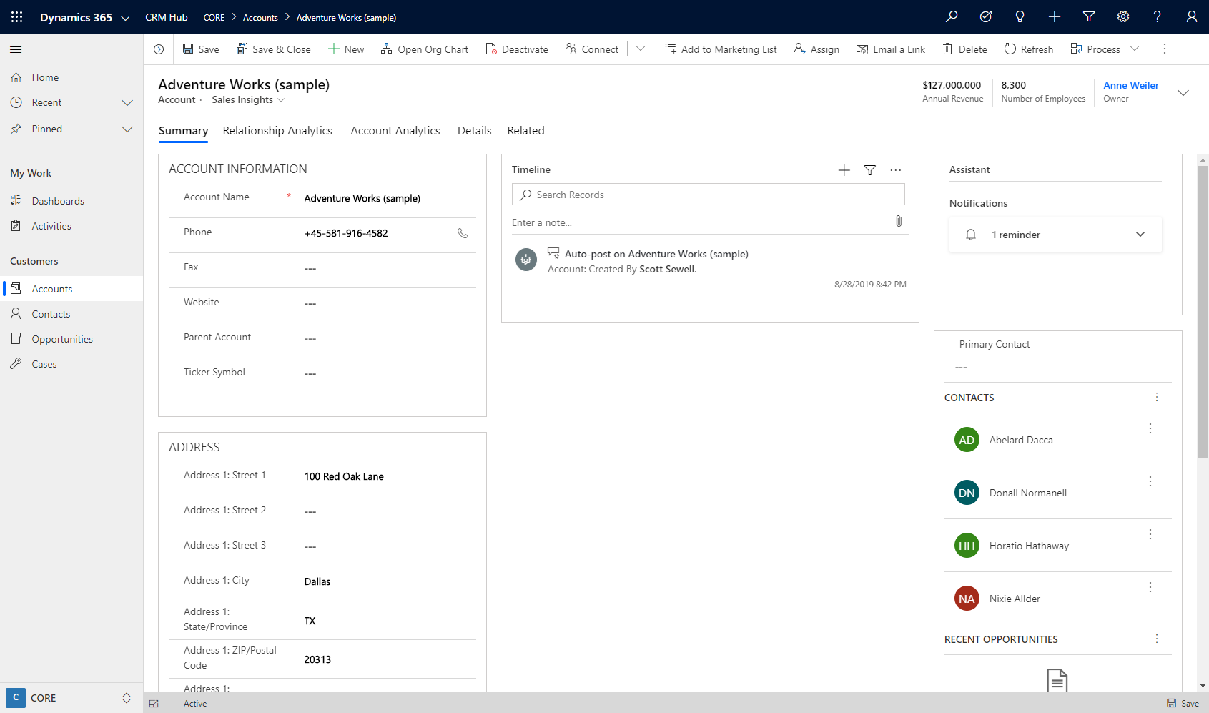
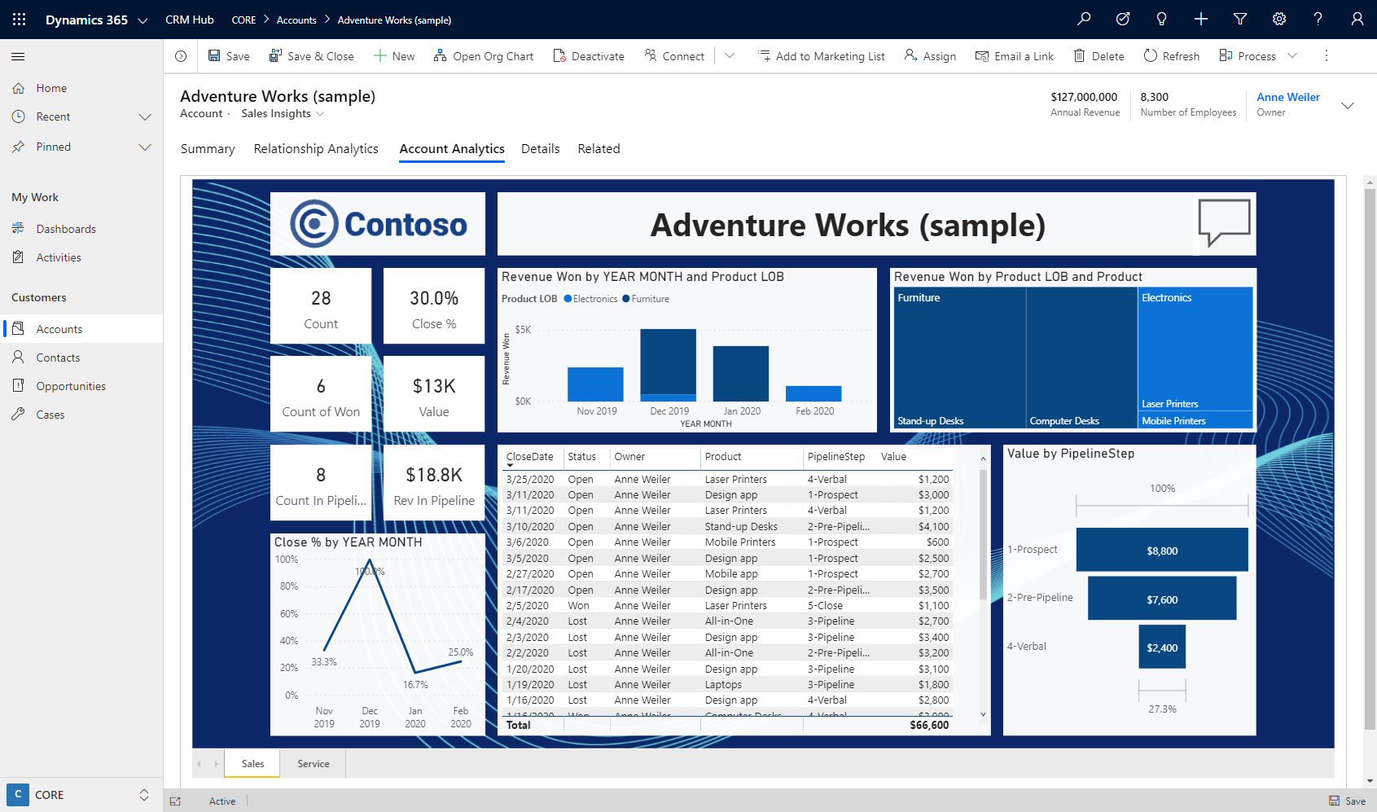
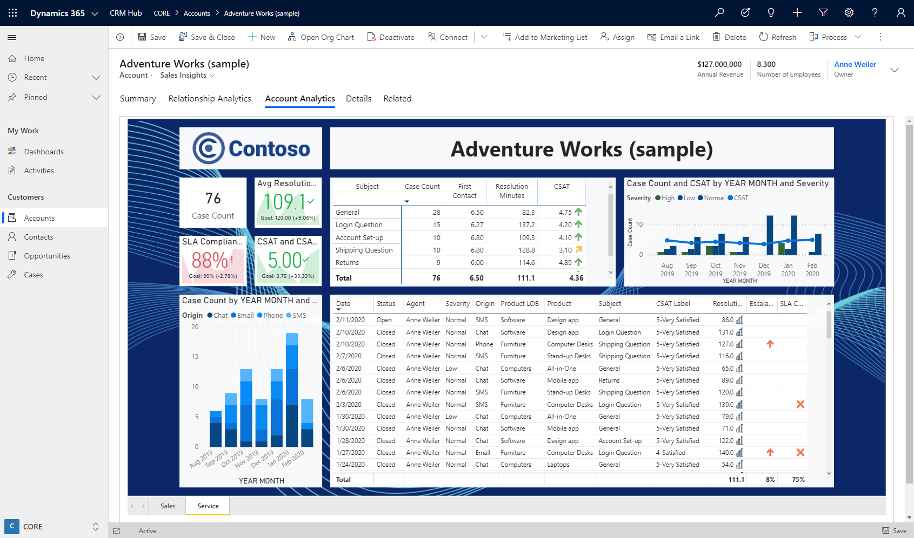
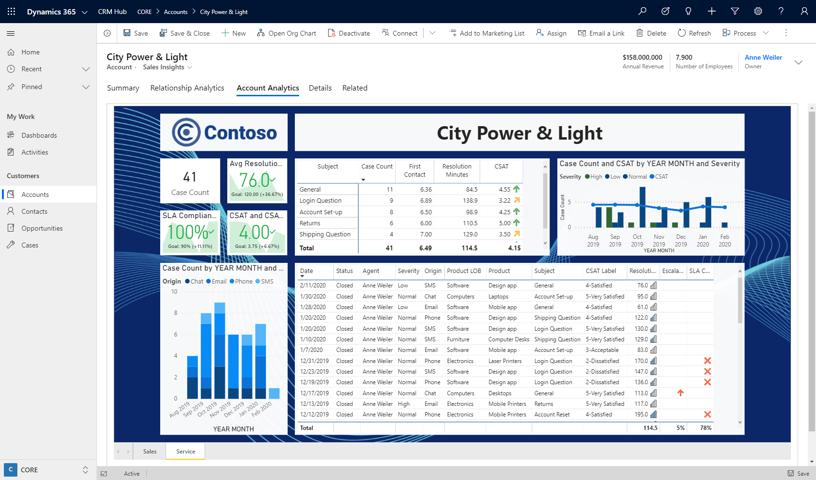
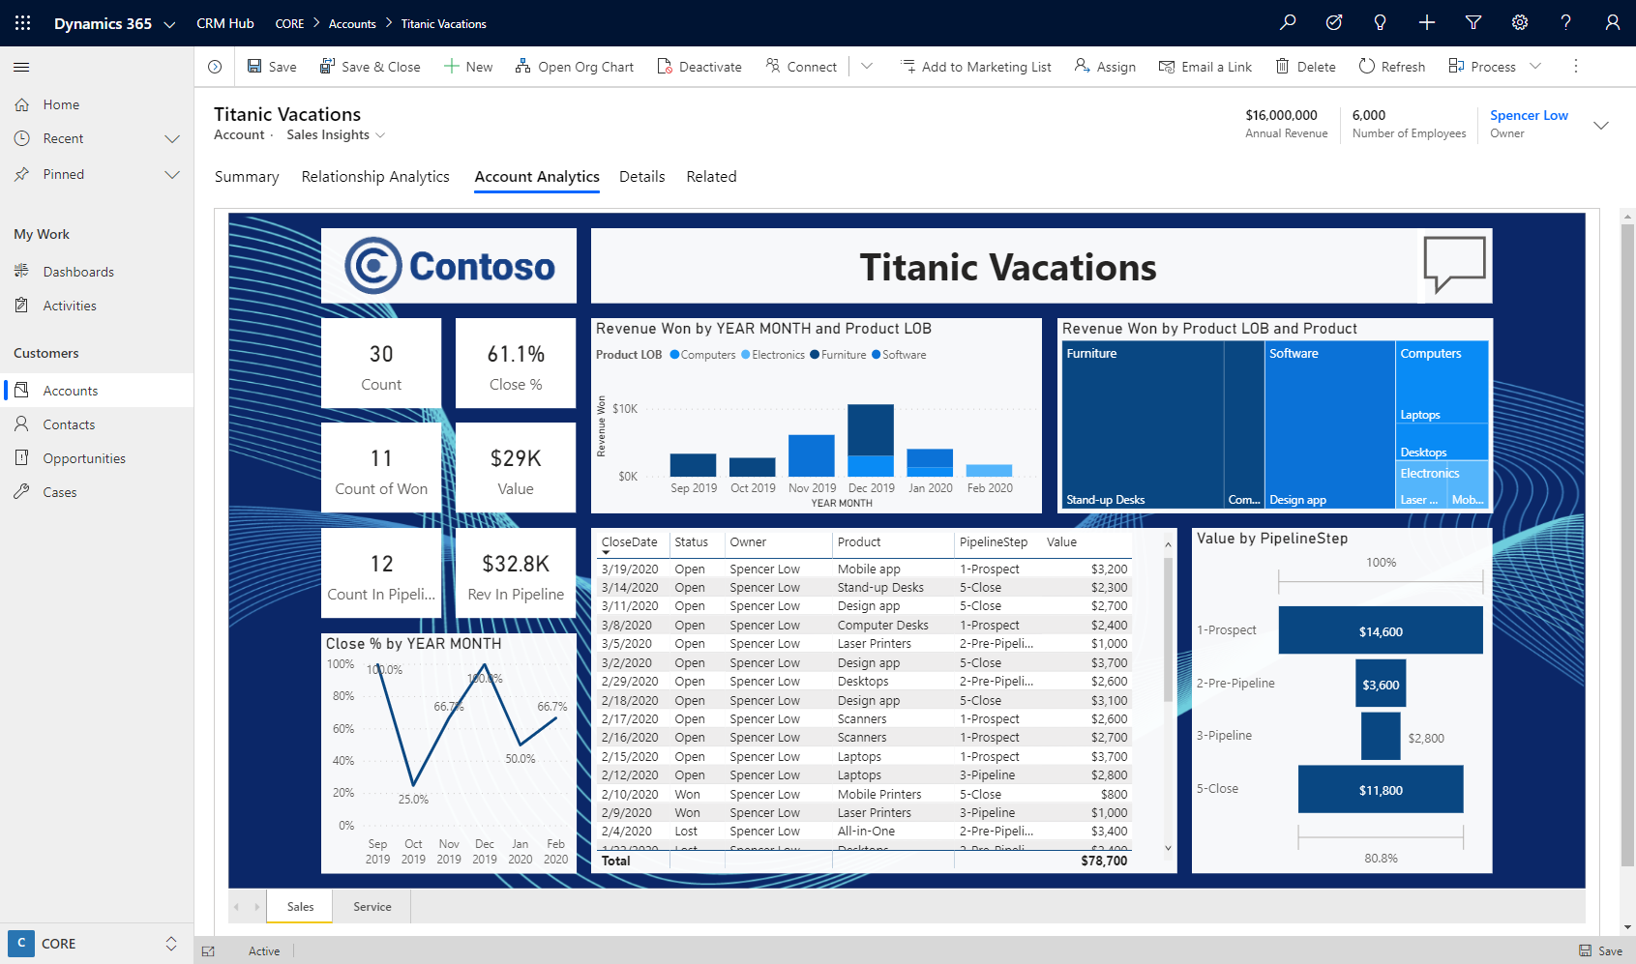
Show Me
Interactive Visualizations
What-If Exploration
No Code AI
Ask Questions, Get Answers
KPIs and Time Series Charts
Analytics on Entity forms

Slide 11
Show Me
Interactive Visualizations
What-If Exploration
No Code AI
Ask Questions, Get Answers
KPIs and Time Series Charts
Analytics on Entity forms

Slide 12

Challenges for Dynamics Technical Specialists
Limited time for builds
Focus is on Dynamics products
Building a realistic dataset is a challenge
Volume
Variety
Interrelatedness
Reloading data in volume is a waste of time

Slide 13
PowerBI Demo Assets for Dynamics Technical Specialists
14 Pre-Built Reports
6 Sales Reports
5 Customer Service Reports
1 Natural Language Query Report
2 Contextual Reports for Accounts
Excel Demo Data File
Modeled on CDS data structure
Formula Driven for Flexibility
Customizable Templates
Re-skin and add Customer Logos
Add/Remove Reports or Visuals
Re-label with Customer’s Terms
Accounts
+ Campaigns, Products, Users, Industries, Territories, etc.
5,000 Opportunities
Contacts
10,000 Service Cases

Slide 14
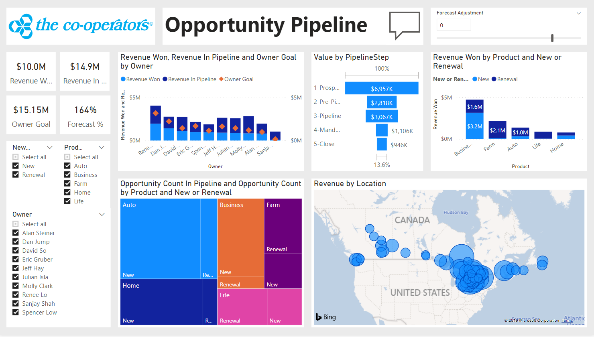
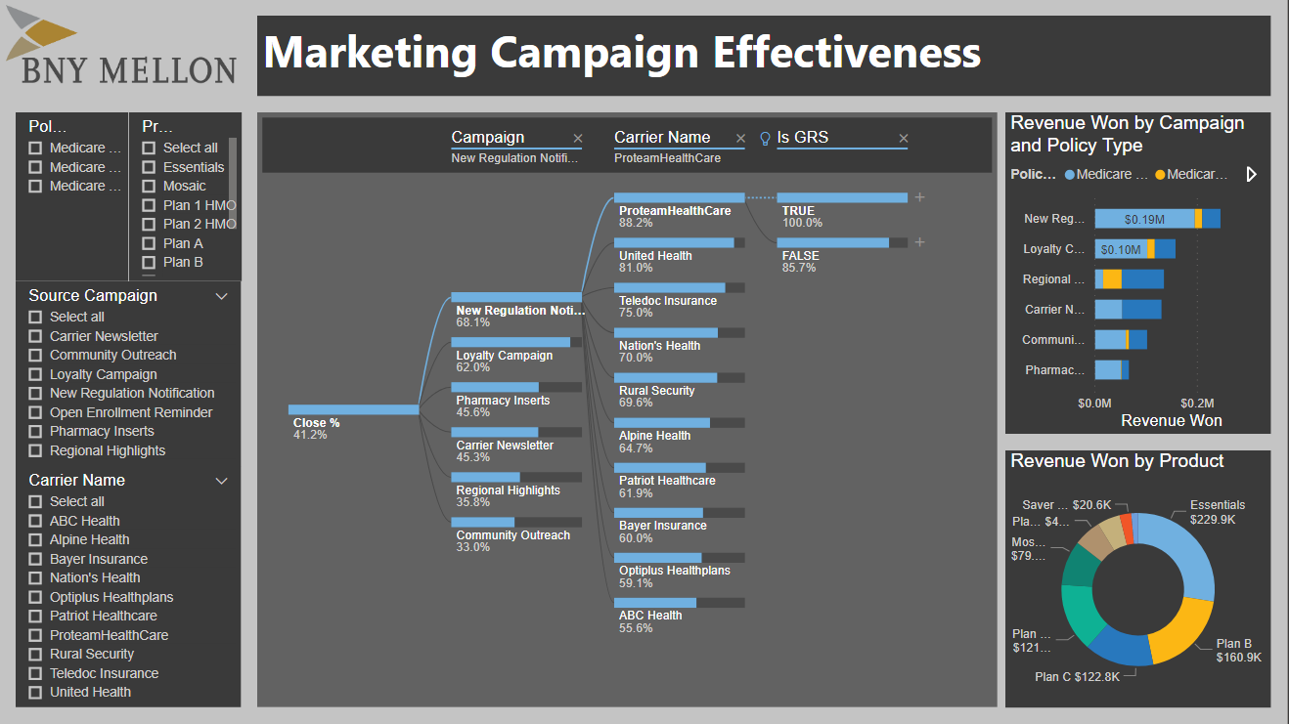
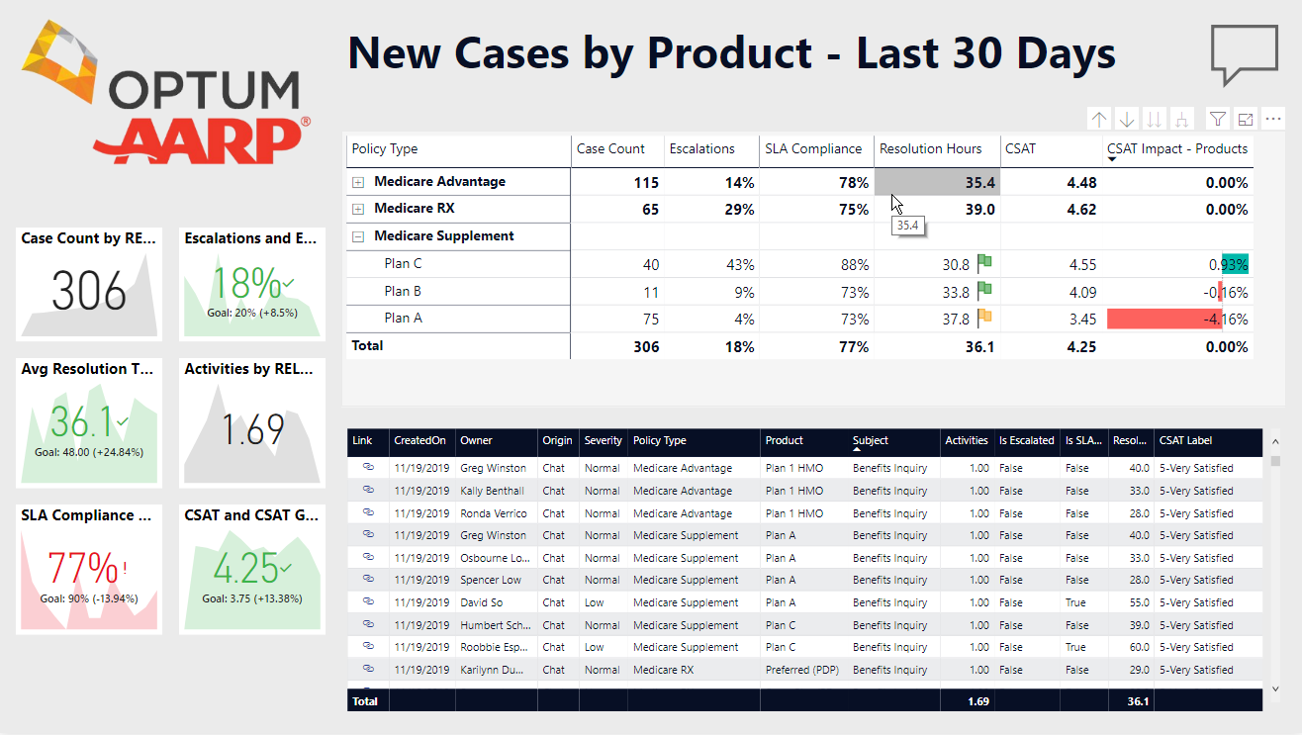
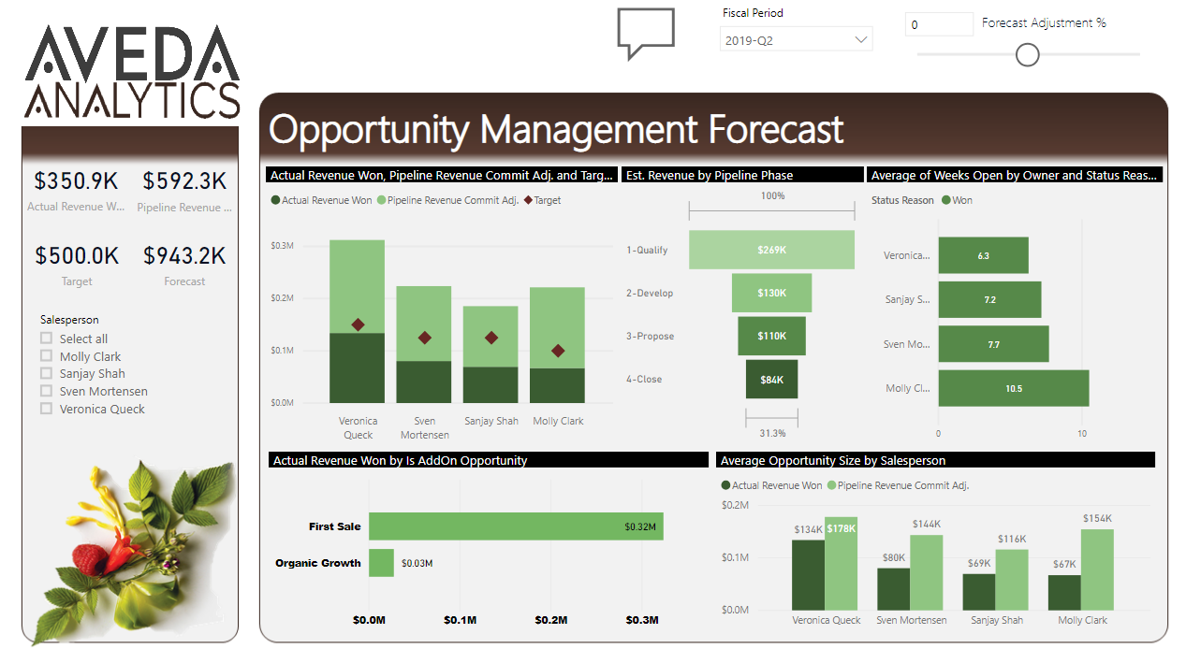

Slide 15
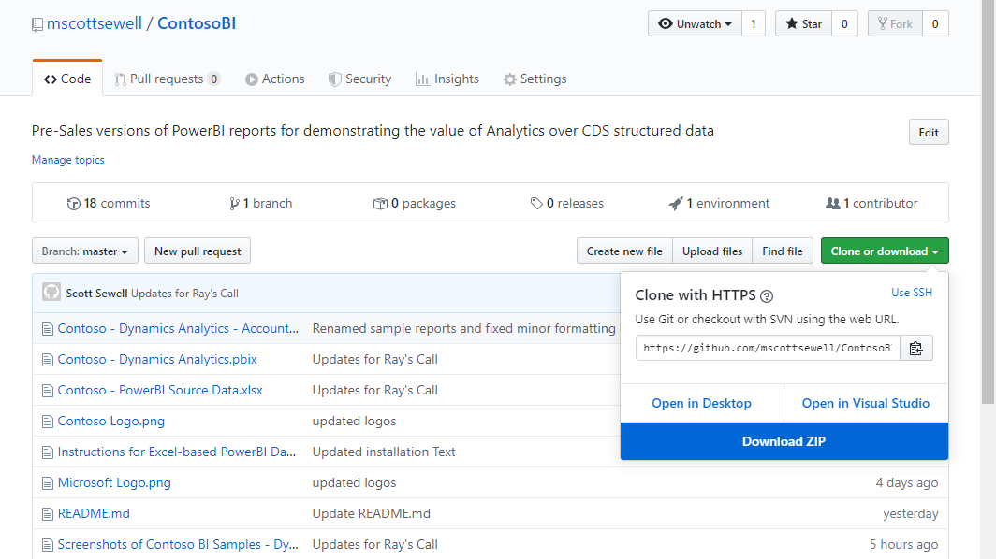
Demo Assets for Dynamics Technical Specialists
https://github.com/MScottSewell/ContosoBI

